Slide 1

ALLWRITE
“AllWrite helps you create a personal digital diary”

Slide 2

TEAM MEMBERS 1. Koshangi dua 2. AKASH TIWARI 3. DIVYA DEVLA 4. ADITYA PARSHAR 5. VARHALA HARSHITH 6. BEJAGAMA CHANDANA
.

Slide 3

GUIDED BY
MR. BALAKRISHNA PALLA
MR. MANMEET JALOTA
MR. ALLWYN GEORGE

Slide 4

Project Introduction 1. Allwrite is trying to get the core of diary entry in digitalized format. It provides a user a digital platform to write their diary entries. 2. This vision is trying to grasp the emotions of people who wants to share their feelings in diaries without revealing their identities.

Slide 5
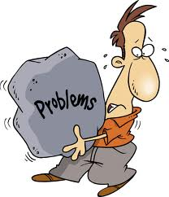

Problem Statement
One big disadvantage of having a diary is that someone might find it and read it without your permission.
Expenses of keeping a diary.
Carrying a diary everywhere can be a little difficult sometimes.

Slide 6

GOAL 1
A digital diary helps you keep your data secure by providing each user an anonymous individual account.
OBJECTIVE
Helping people adapt modern and digitalized way of keeping a diary.
GOAL 2
This platform allows a user to write unlimited number of diary entries.
GOAL 3
Users can anytime login through their digital devices without making an extra space for a physical diary.

Slide 7

PRODUCT FUNCTIONS
Profile management
Diary entry
1. Upload Entry
2. Update existing entry
3. Delete entry
Checking Feed

Slide 8

PROFILE MANAGEMENT
Login
Username/ password =
and login
Registration
1. Click Sign Up
2. Name, email, user description, password
3. Click submit

Slide 9

DIARY ENTRY 1. User can add their new diary entries with date. Content will be in text format only. 2. They can anytime edit the existing diary entry re share it. 3. Diary entry can be deleted by the user.

Slide 10
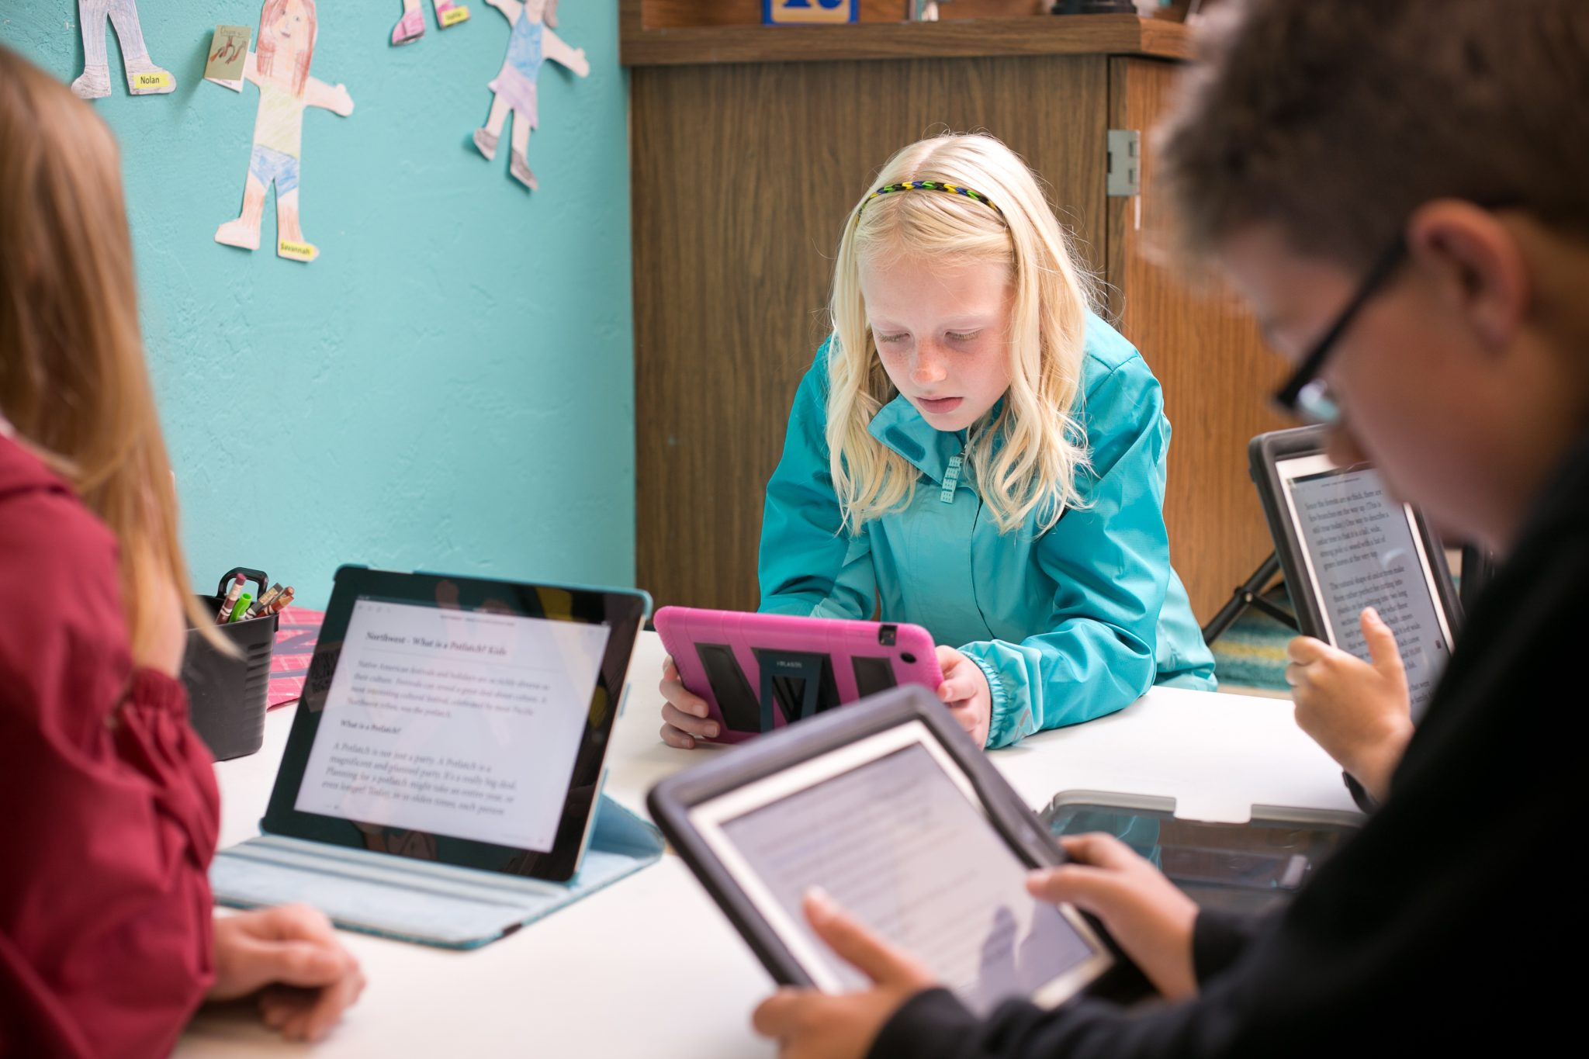
FEED CHECKING
Each user can read the diary entries of other users.
Click on “view all” tab and enjoy reading, but the identity will remain anonymous.

Slide 11
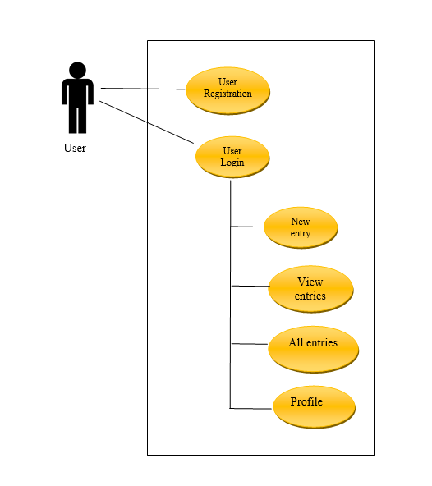
USE CASE DIAGRAM

Slide 12
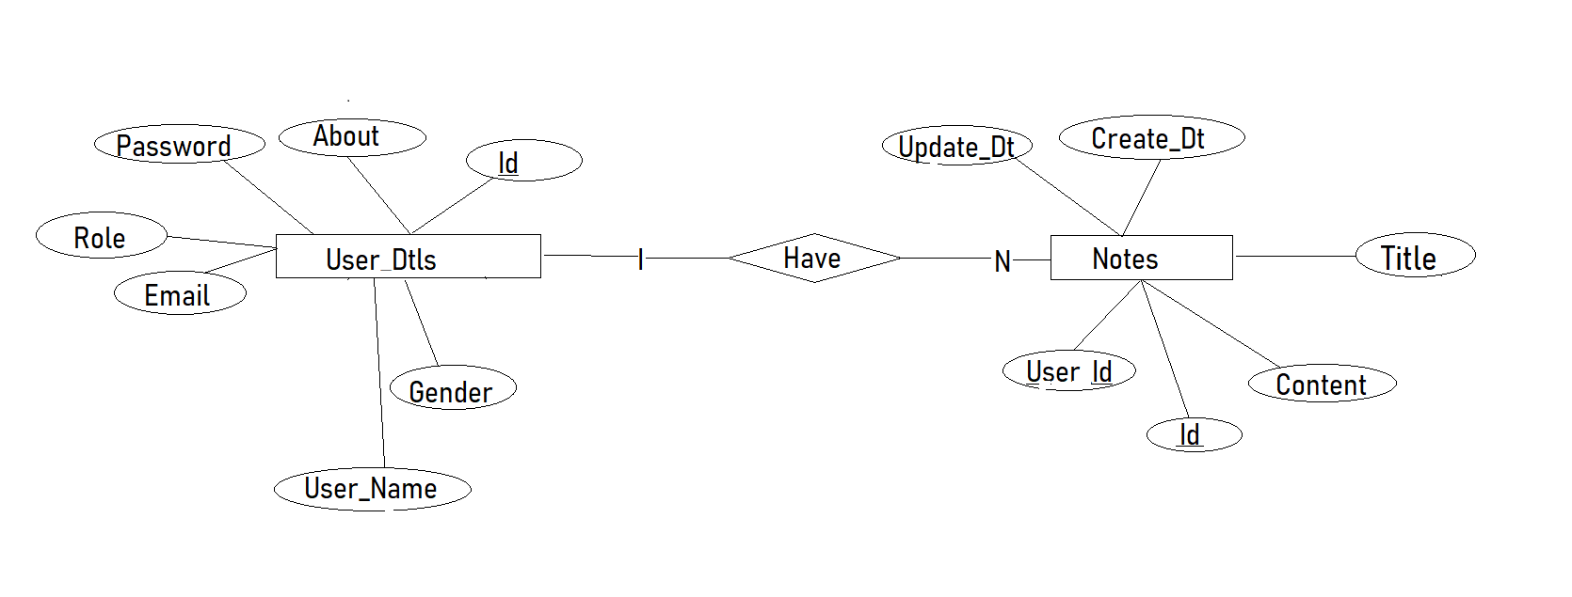
ER- DIAGRAM

Slide 13
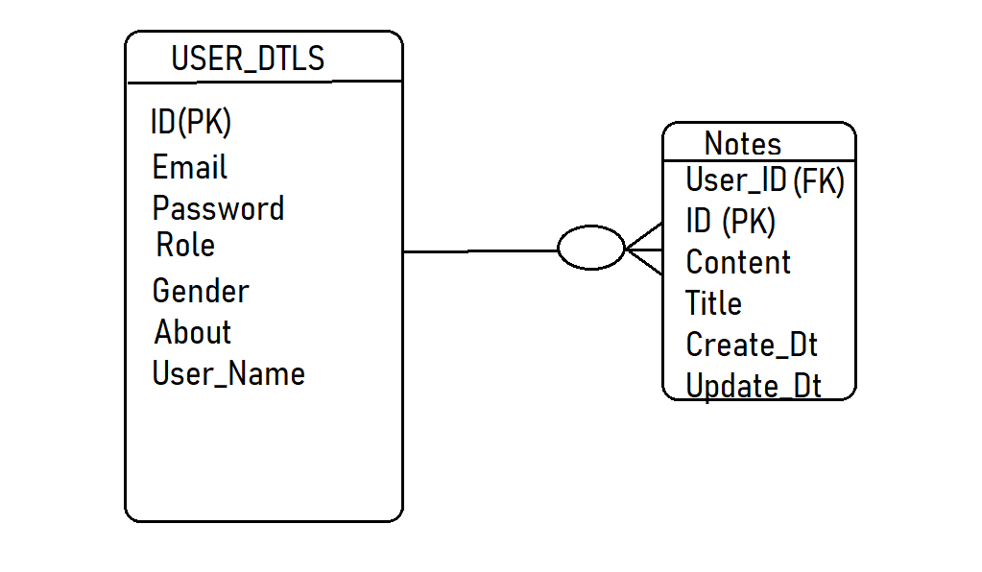
ACTIVITY DIAGRAM

Slide 14







ORACLE DB
HIBERNATE ORM
HTML CSS
JAVASCRIPT
JAVA ECLIPSE
BOOTSTRAP
USED TOOLS AND TECHNOLOGY

Slide 15
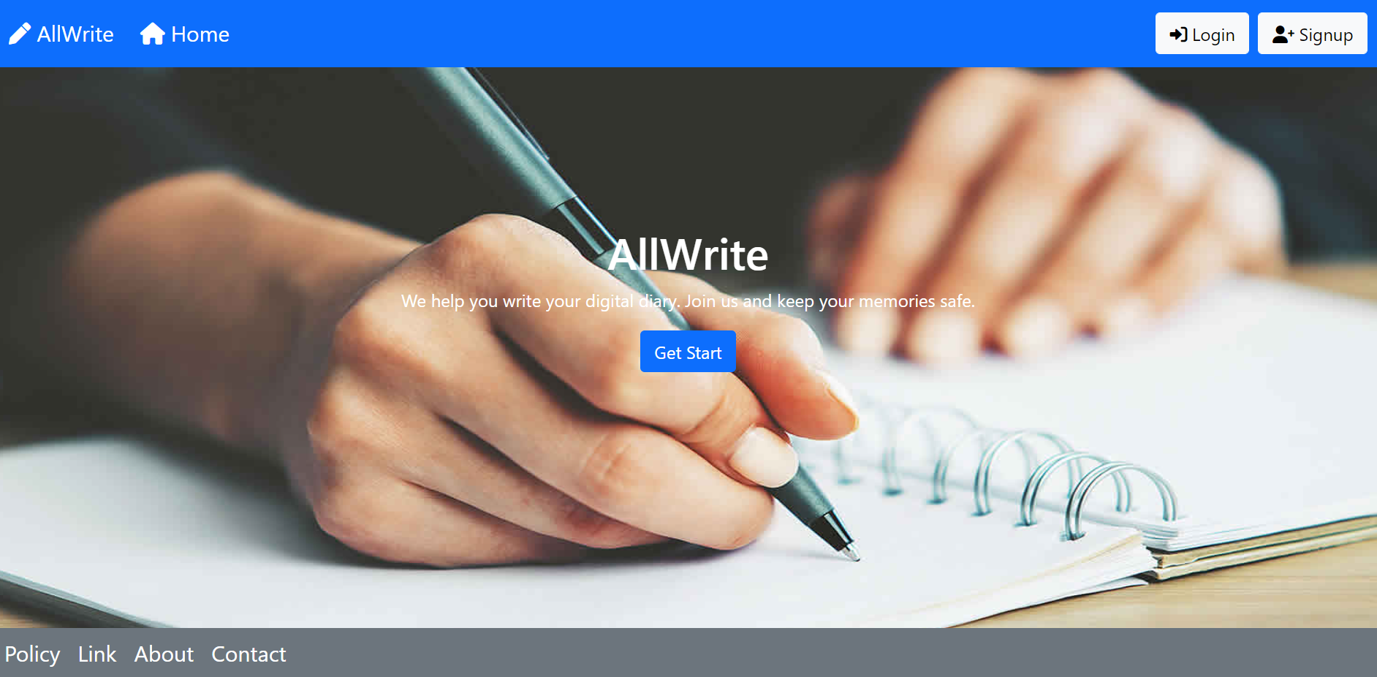
PROJECT DEMONSTRATION

Slide 16


FUTURE ENHANCEMENT
Comment box will be added in VIEW ALL tab.
A profile icon will be there for each user.

Slide 17
THANKYOU
“

